Slide 1
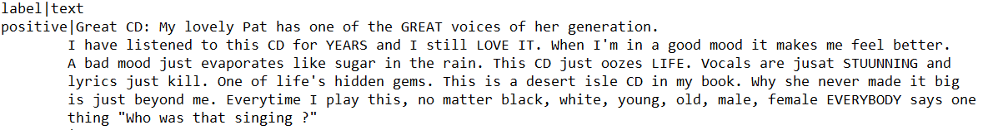
Introduction
The dataset consist of 0.4 million records. The records have two columns, separated by ‘|’ as the delimiter:
First column being the category of Amazon’s product review by customer. It has two categories/classes: Positive and negative
The second is the textual data written as review comments by the customer.
The dataset being huge could not used in all for training and testing models. Thus, tried the set of different values like 5000,10000,
20000 records, I finally settled with a sample size of 10000 records. I chose this value because:
Among all values tried, my pre-processing steps and model training took reasonable time
System did not ran out of memory with this dataset size
Maximum amongst all values tried that satisfied above two constraints.
Even having this size of dataset, multiple runs of entire algorithm gave consistently good results

Slide 2
Preprocessing
Data sampling
The experiment of algorithm with a random sample of 10000 records did not give good results. Digging deeper into the probable root cause of this bad accuracy, tried to go for stratified sampling. Thus, segregated positive class reviews and negative class reviews in two separate datasets. Then, observed that the distribution of number of records of each class was almost equal. Thus, selected 5000 records from each class as a random sample. Afterwards, joined these two into one final dataset.
Cross validation
I used holdout cross validation for separating test and the training data from the data sample; a holdout with 80% values in the training set and remaining 20% in the test set. To maintain equal presence of each class in rain and test data, selected 4000 records from each class’s sample into training set and 1000 records of each class into test set.
Data cleaning
The feature set of the records is nothing but a plain text. We had to extract keywords from the textual data that could project the sentiment behind the words used by the customer.
we removed the stop-words from the text. This step removed irrelevant words from being a factor impacting the sentiment of the customer.
We had to catch the frequency of use of some relevant words amongst all reviews. Thus, to compare equality of words, they needed to be in same letter case. Thus converted all the text reviews to lower case.
Moreover, removed some of the punctuation marks that may create problems in actual word match and frequency count, like full stop, comma, apostrophe, double quotes and exclamation mark.

Slide 3
Dataset 3:Amazon Reviews for Sentiment Analysis Problem: The problem is to find a classifier for this dataset that has high accuracy and left and top corner approaching ROC plot value.

Slide 4
Feature Extraction
We used TFIDF for feature extraction on the review text.
TFIDF is the term frequency inverse document frequency based algorithm. The idea behind it’s use was that we wanted to fetch words with highest frequency of occurrence within a review and within all reviews of same class and use this information as the feature set. We got numerical values of around 37000 dimensions for each record.
We had to reduce dimensions to a reasonable number. Thus, after experimenting with value of 60,100,120 we settled with a count of 100, as this performed well on prediction of results.
Moreover, to further improve accuracy, we used the sentiment classifier of Mathematica.
This tool gives a class label as positive, negative or neutral for a set of words. Appending this label with above 100 features did not produce better results. Thus, we fetched the probabilities behind the sentiment classification of records for each class: positive, negative and neutral. These three numeric values were appended with previous 100 dimensions.
Final, feature set had a dimension of 103.

Slide 5
Modelling techniques
Decision Trees
Random forest is an ensemble method based on decision trees for classification. It constructs multiple decision trees based on a variety of attributes taken into account and then outputs the mode of the classes of the individual tress. It avoids overfitting of data. Because the random sample size is less comparable to original data set, overfitting avoidance is a good idea.
Neural Networks
Neural network is a programming and modelling technique based on human brains. It easily detects complex non linear relationships between variables. Although its prone to overfitting, but deep learning implementation of Mathematica’s Neural Network classifier is good to avoid overfitting and performs better than random forest. Neural network has a black box structure that maintains a hidden implementation of the actual model trained on training data. Neural networks is known to perform excellent on image classification, text classification, hand written data classification.
Support vector machines
I tried with probabilistic classifiers like Naïve Bayes and Markov, but did not achieve good predictions. Thus, I had to choose a non probabilistic classifier. Thus, I headed for SVM. Moreover, SVM creates a large margin separator between classes that ensures less overfitting errors due to noise. Moreover, SVM are known to be helpful in text and hypertext classification.

Slide 6
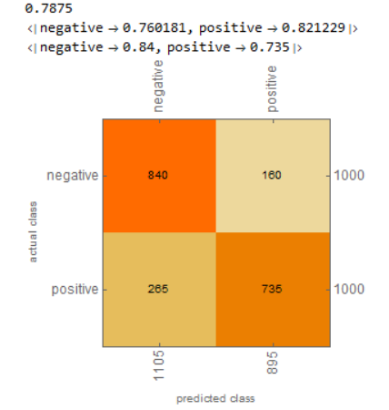
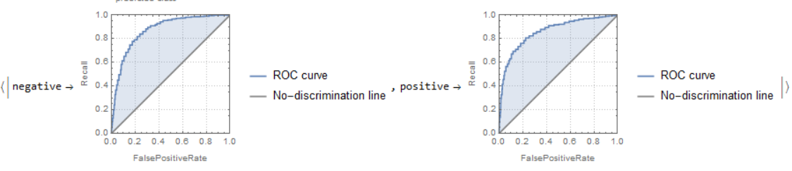
Experiments and Results
All the algorithms were executed on a stratified sample dataset of 10000 records. The experiment was executed for 4 iterations to obseve more or less consistent performance.
Random Forest: The accuracy varied between 76-79%. The results on the last run are as follows:
Parameter | Percentages/Visualisations
Accuracy | 78.75%
Precision: Negative Positive | 76.02% 82.12%
Recall: Negative Positive | 84% 73.5%
Confusion matrix
ROC Curve

Slide 7
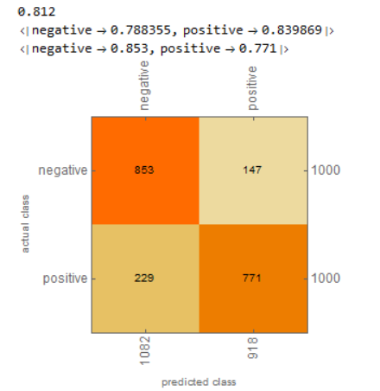
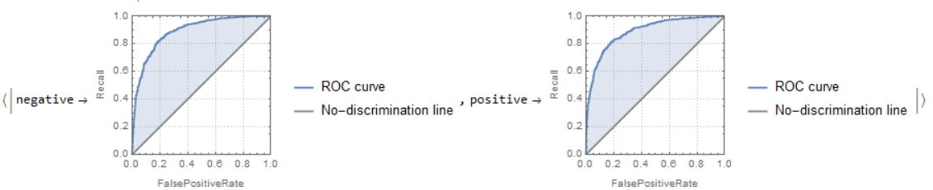
2. Neural Networks: The accuracy varied between 80-82.5%. The results on the last run are as follows:
Parameter | Percentages/Visualisations
Accuracy | 81.2%
Precision: Negative Positive | 78.83% 83.98%
Recall: Negative Positive | 85.3% 77.1%
Confusion matrix
ROC Curve

Slide 8
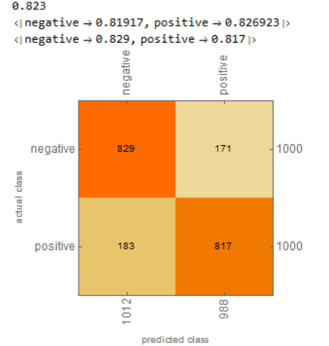
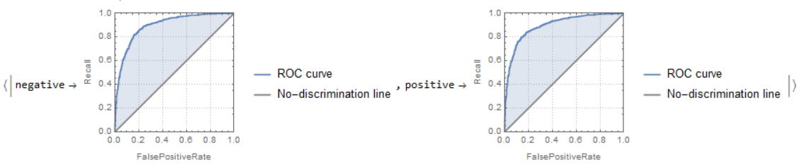
3. Support Vector Machine: The accuracy varied between 81-84%. The results on the last run are as follows:
Parameter | Percentages/Visualisations
Accuracy | 82.3%
Precision: Negative Positive | 81.9% 82.7%
Recall: Negative Positive | 82.9% 81.7%
Confusion matrix
ROC Curve

Slide 9
Visualisation of comparisons

